Slide 1
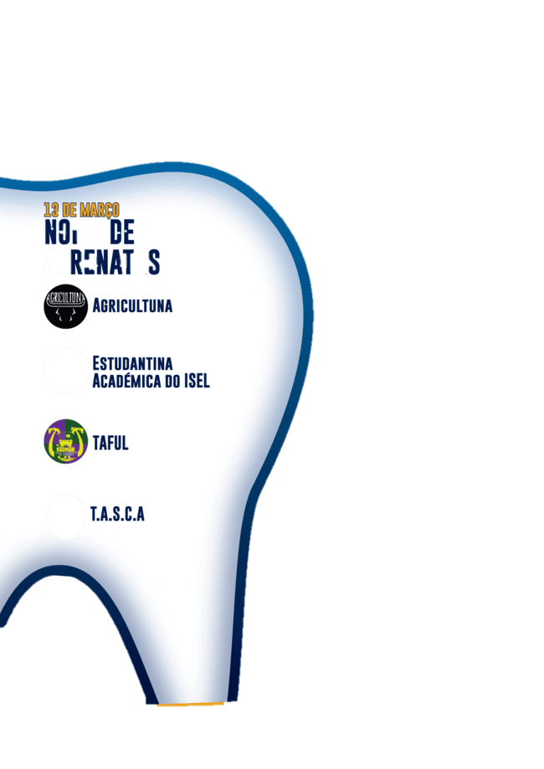






I.O.F.O.S. INTERNATIONAL COURSE IN FORENSIC ODONTOLOGY
AGE ESTIMATION WORKSHOP
July 7-11, 2025
Florence, Italy
Recapitulation, ending
Prof. Cristiana Palmela Pereira
July 11, 17:30 pm

Slide 2
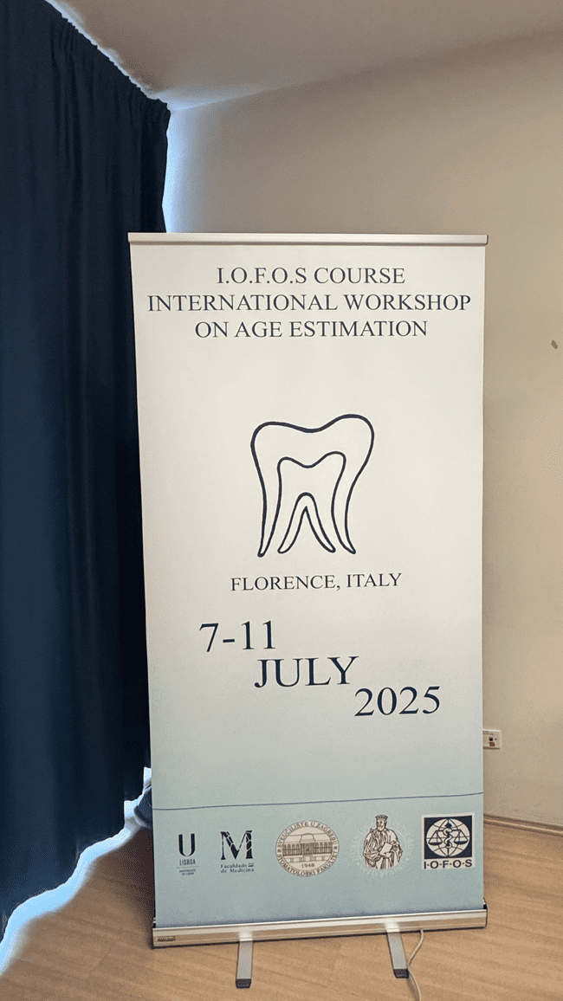
I.O.F.O.S. INTERNATIONAL COURSE IN FORENSIC ODONTOLOGY
AGE ESTIMATION WORKSHOP
July 7-11, 2025
Florence, Italy
FIRST DAY

Slide 3
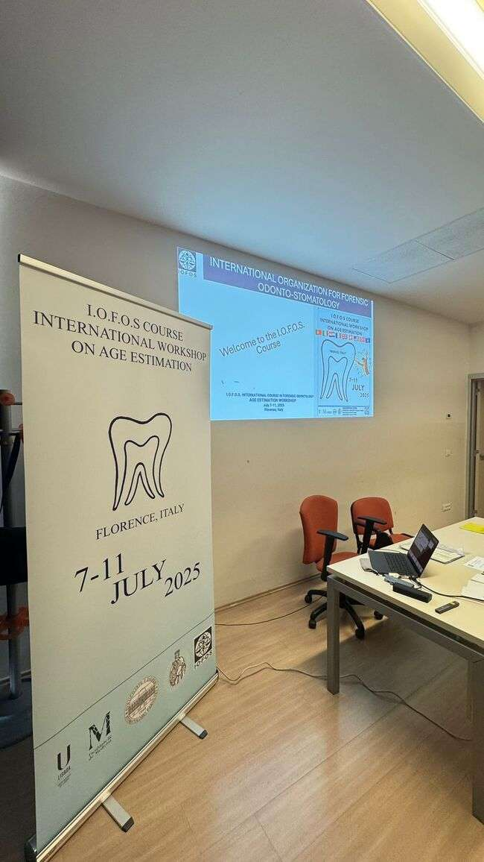
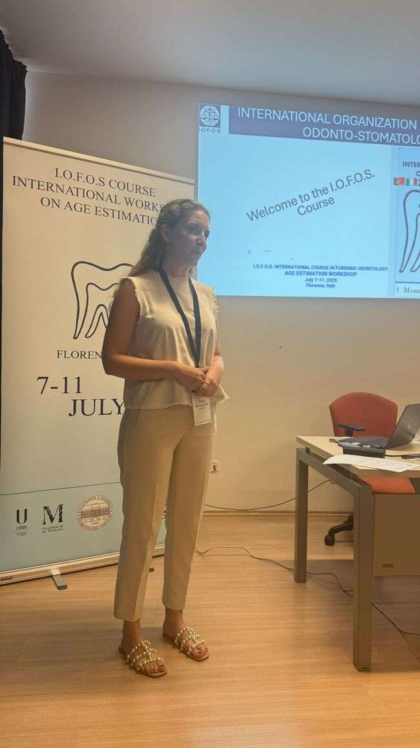
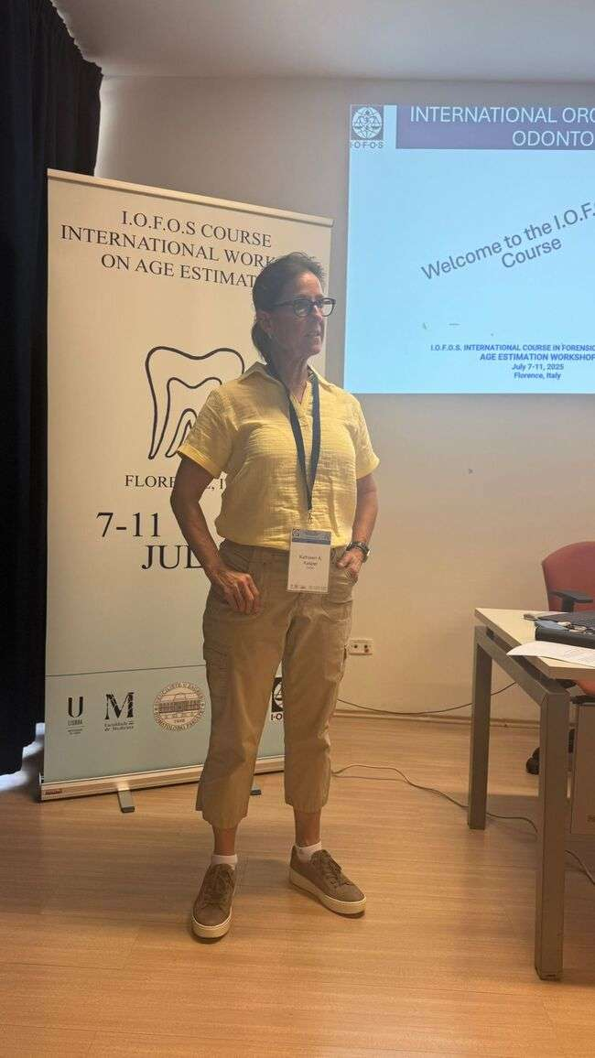
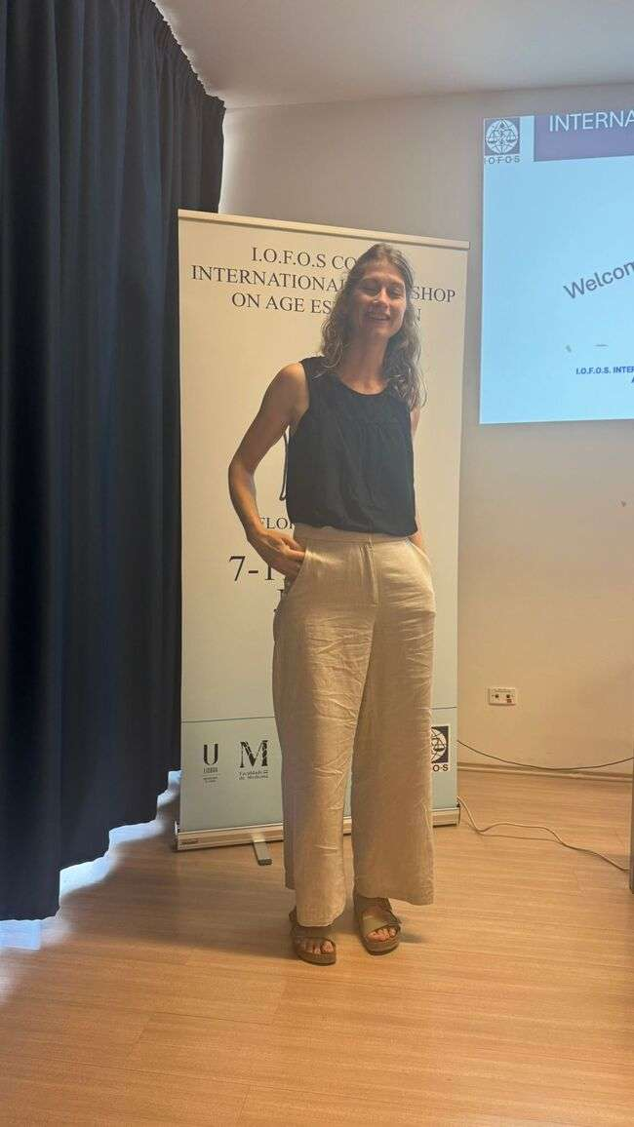
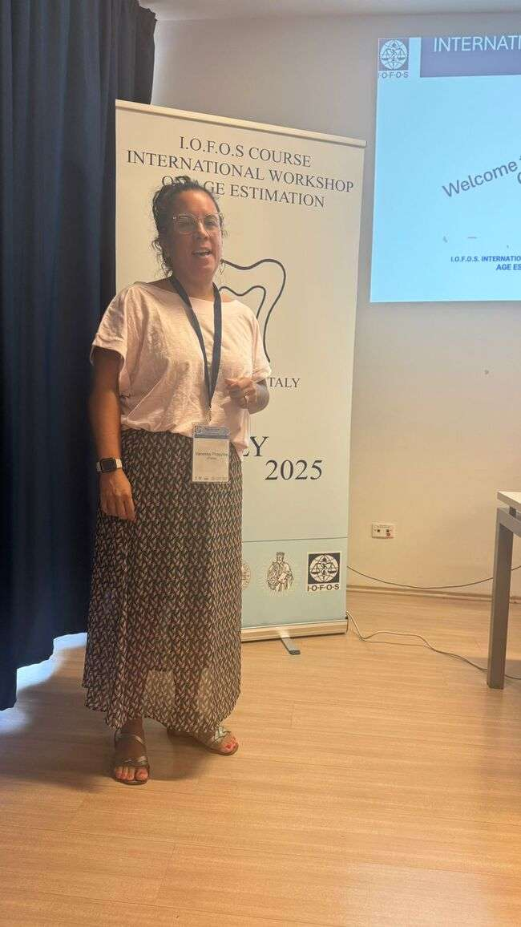
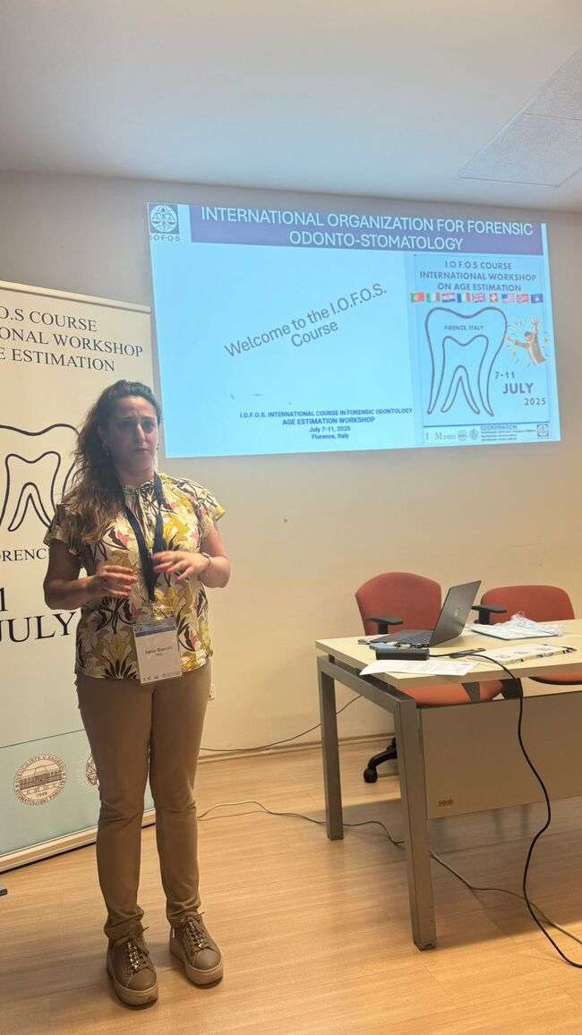
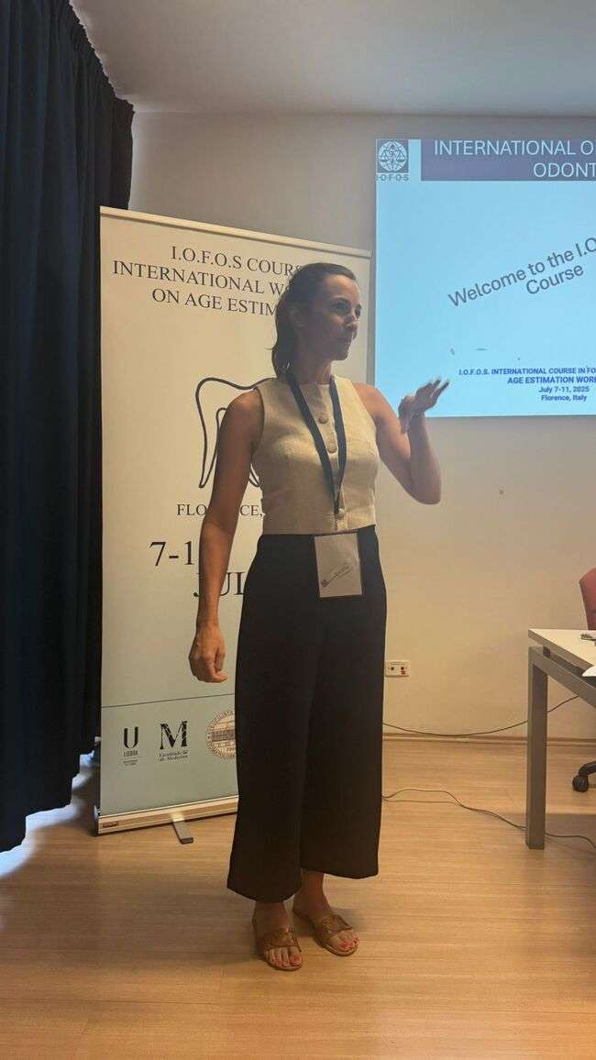
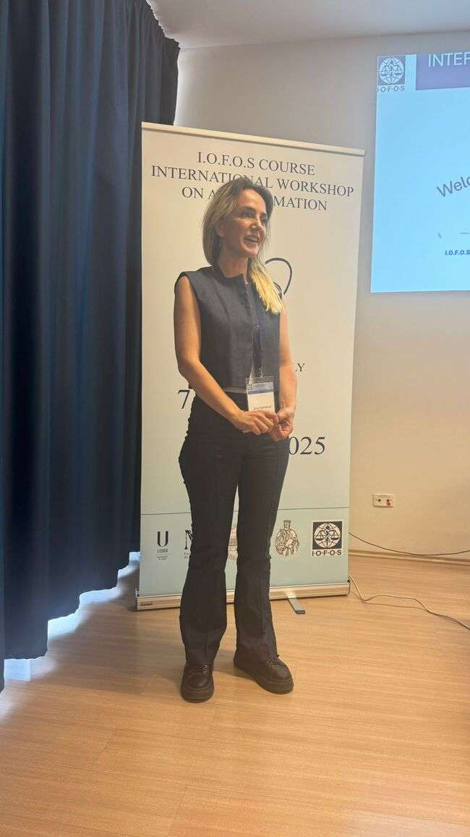
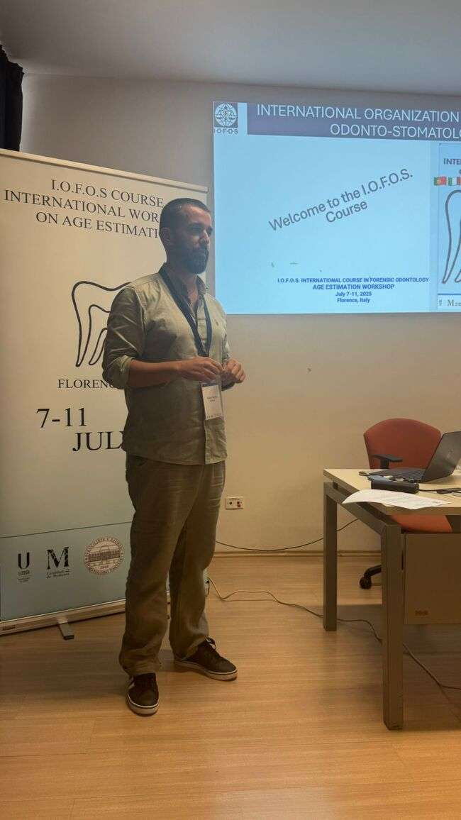

Slide 4
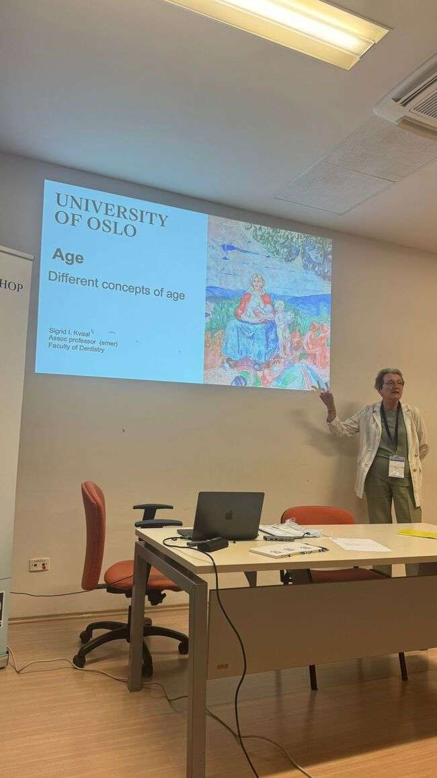
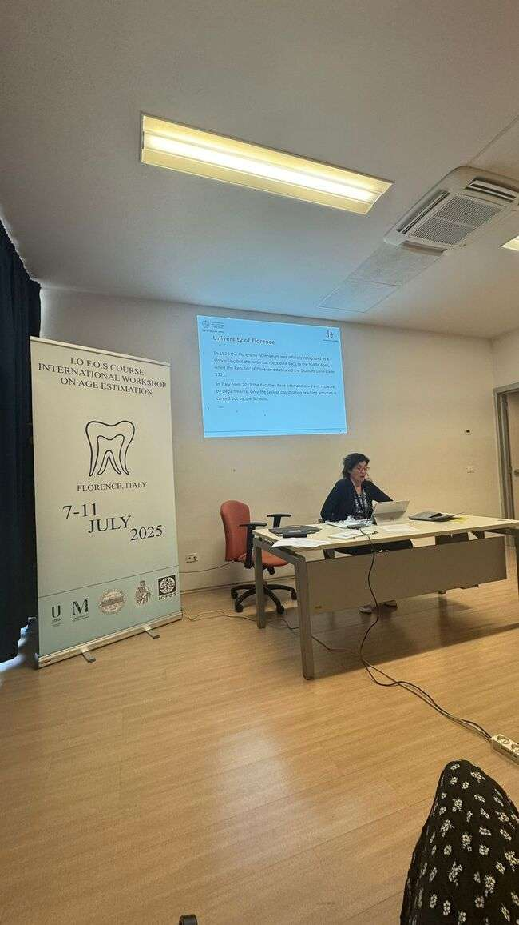
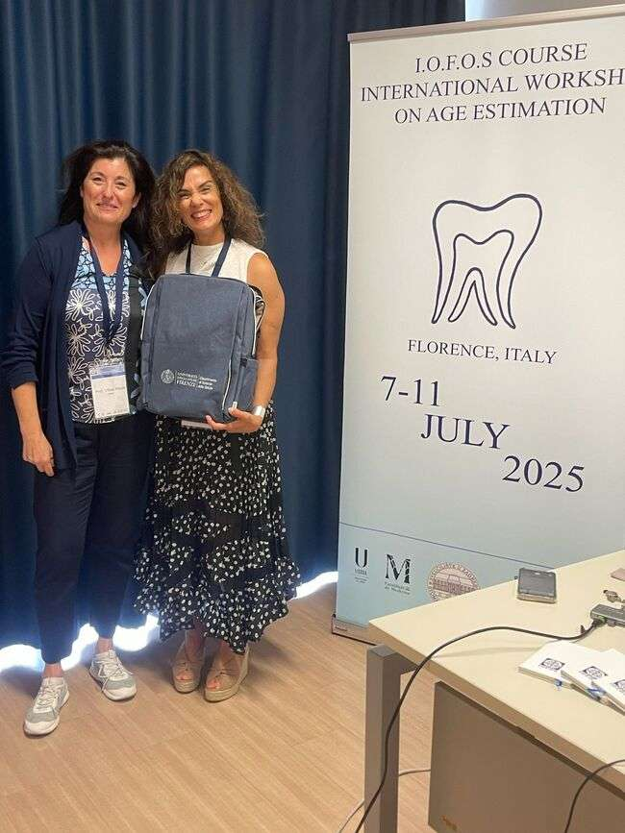
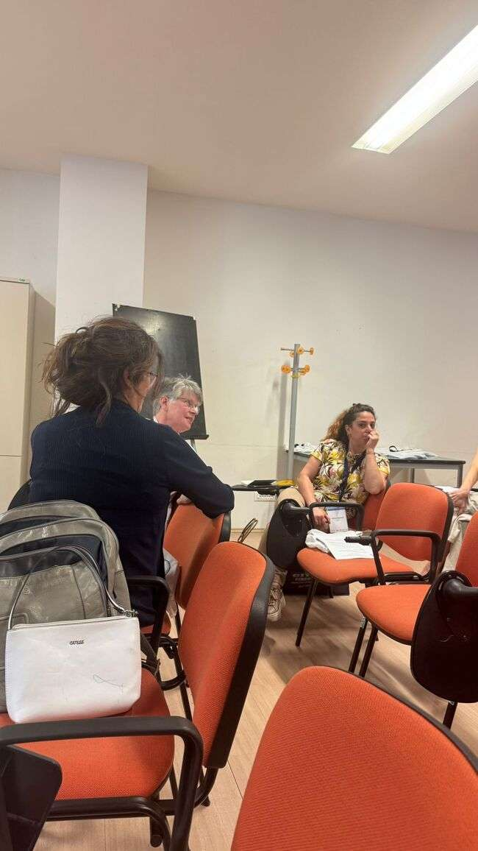
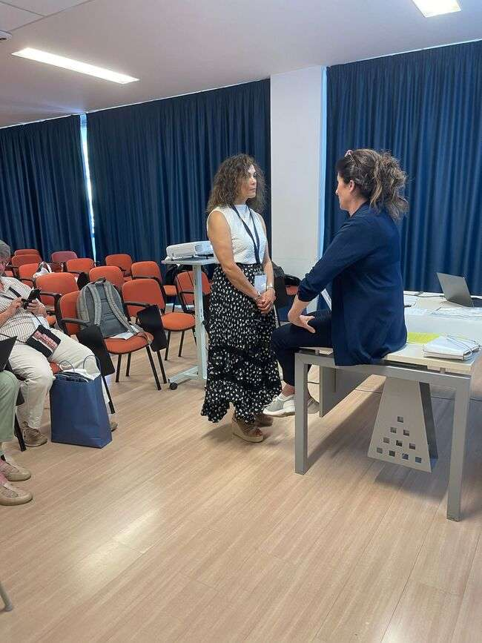
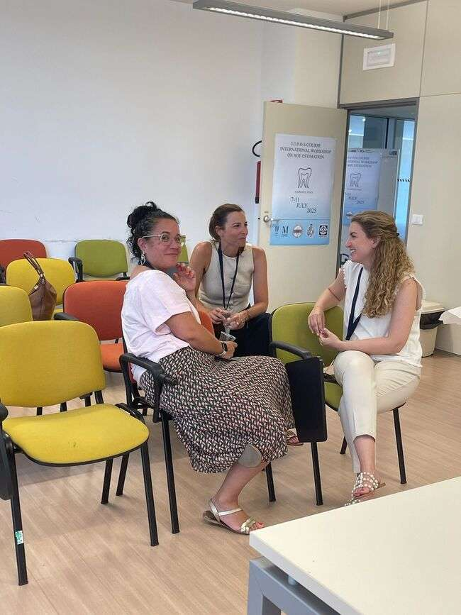
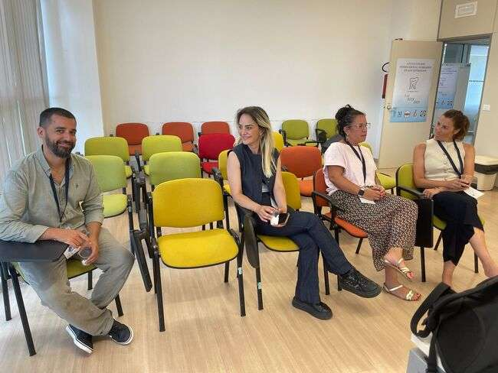

Slide 5
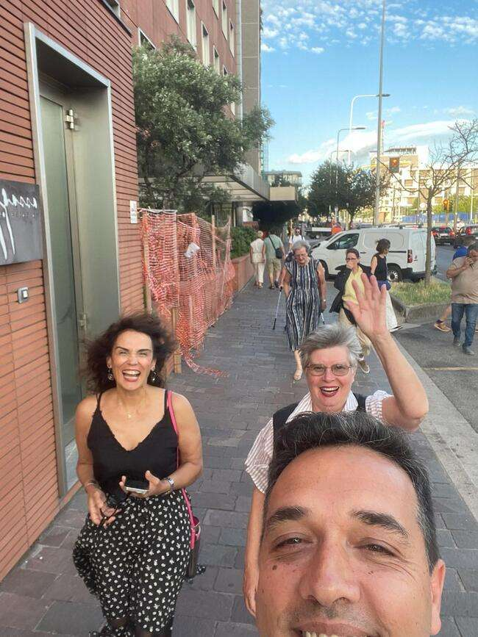
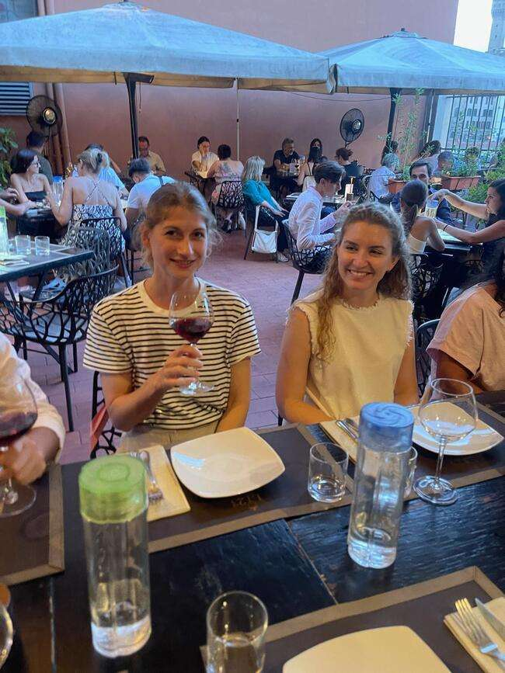
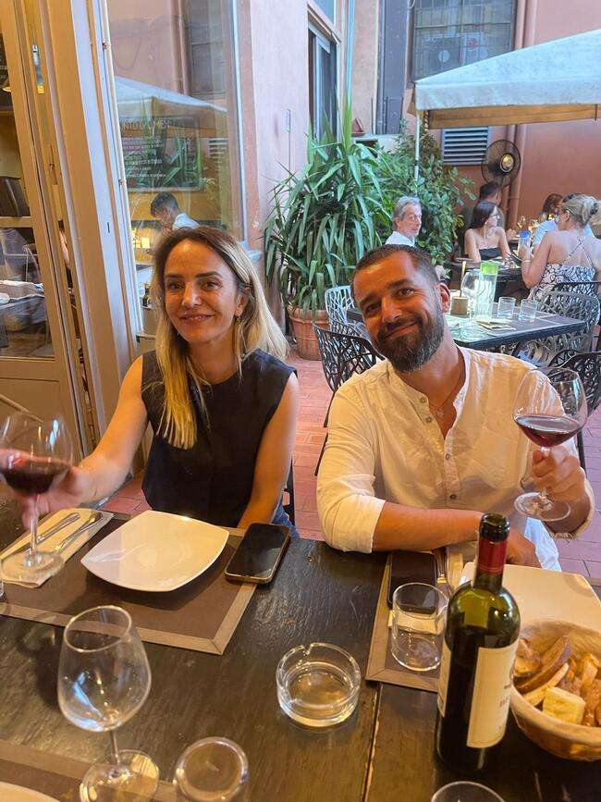
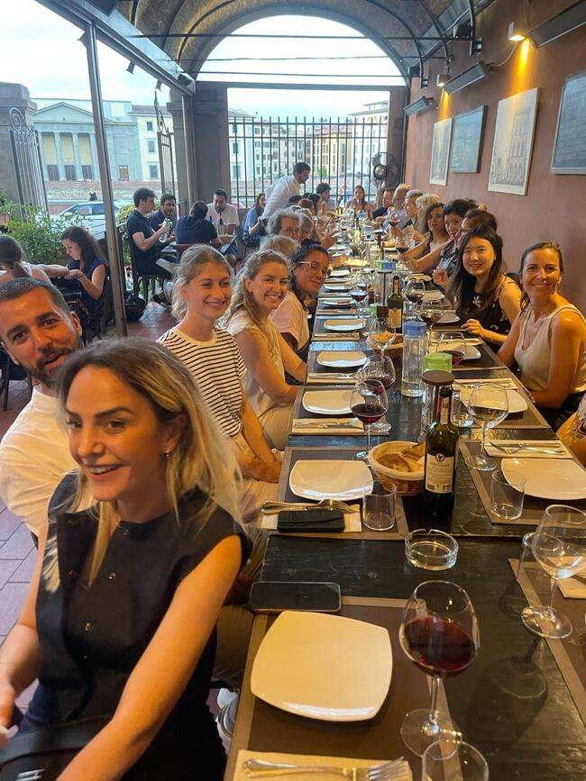
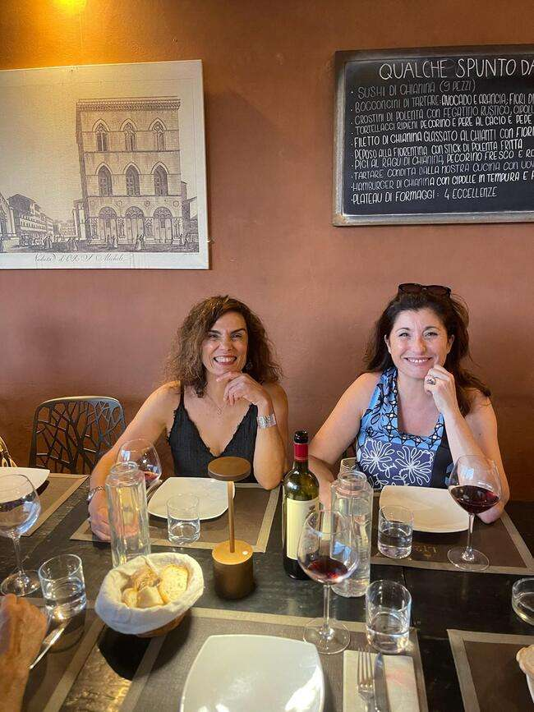
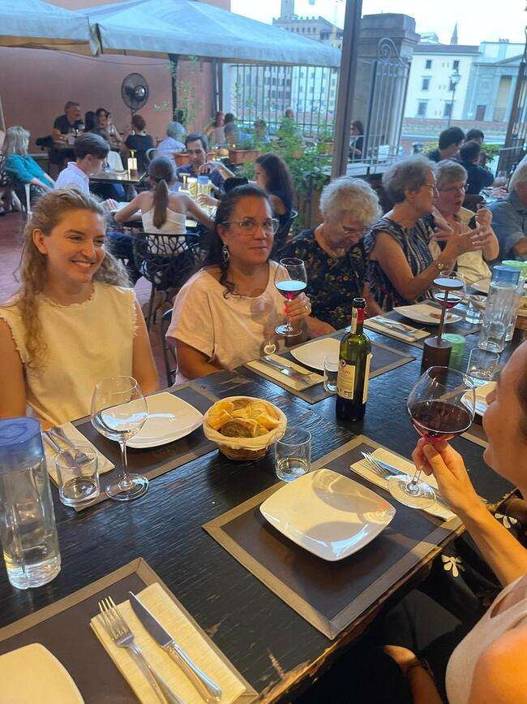

Slide 6
I.O.F.O.S. INTERNATIONAL COURSE IN FORENSIC ODONTOLOGY
AGE ESTIMATION WORKSHOP
July 7-11, 2025
Florence, Italy
SECOND DAY

Slide 7
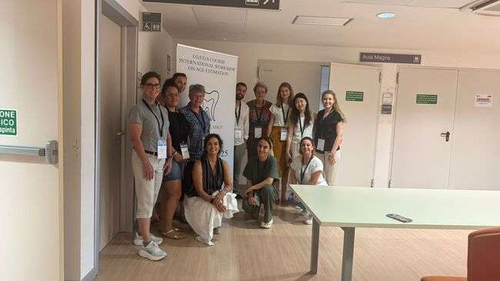
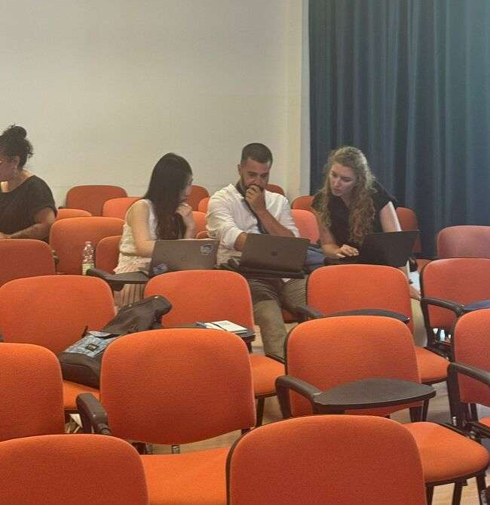
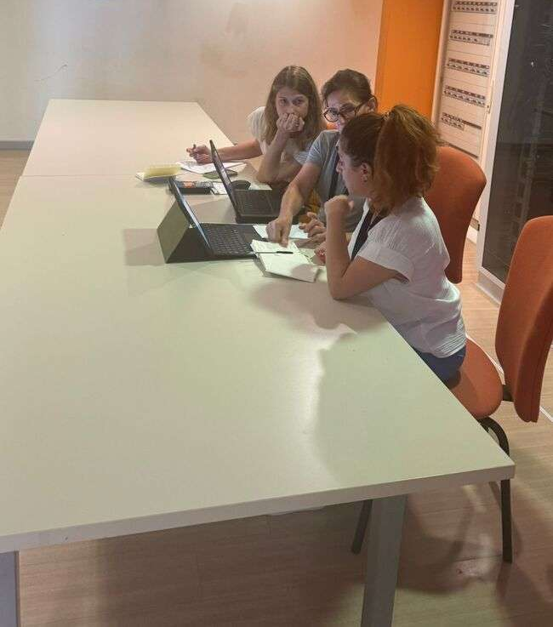
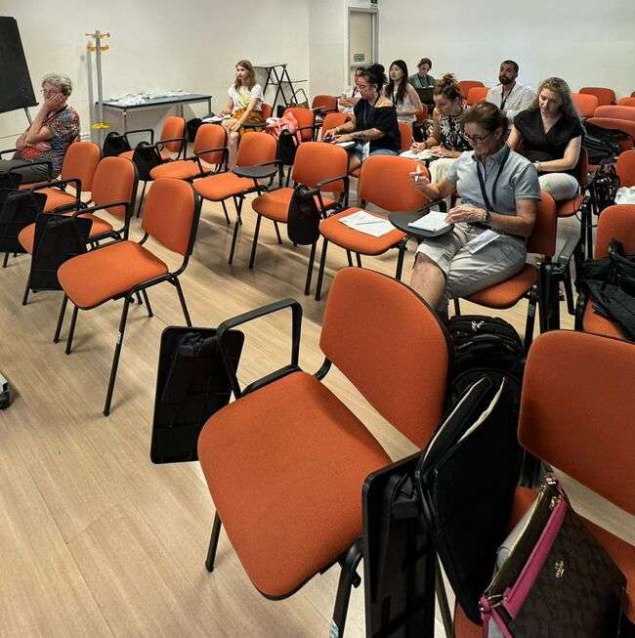
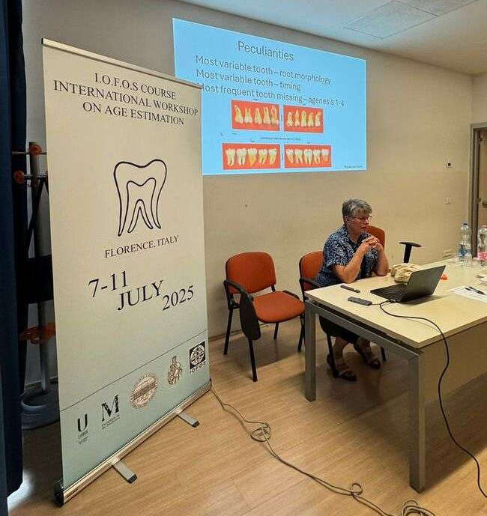
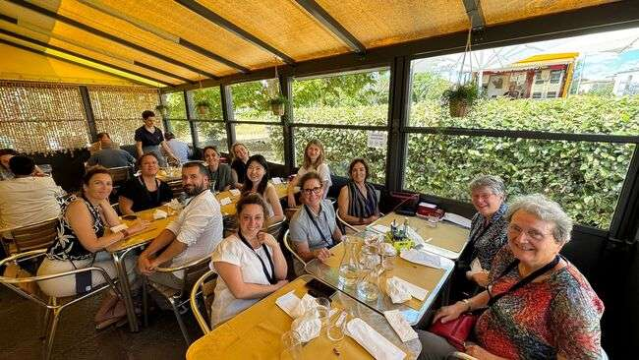
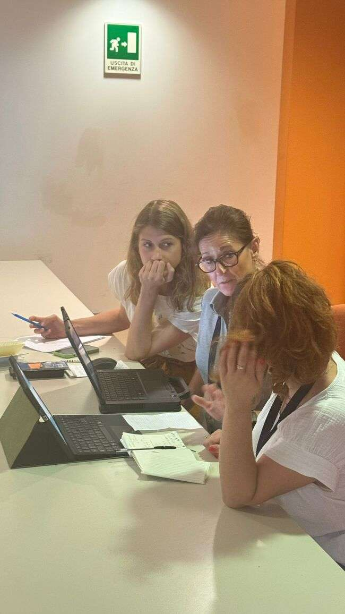

Slide 8
I.O.F.O.S. INTERNATIONAL COURSE IN FORENSIC ODONTOLOGY
AGE ESTIMATION WORKSHOP
July 7-11, 2025
Florence, Italy
THIRD DAY

Slide 9
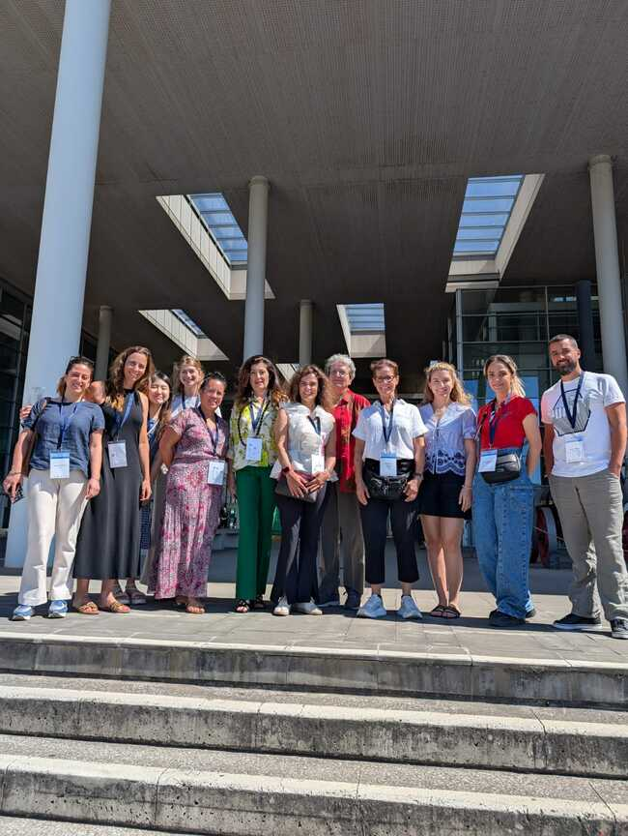
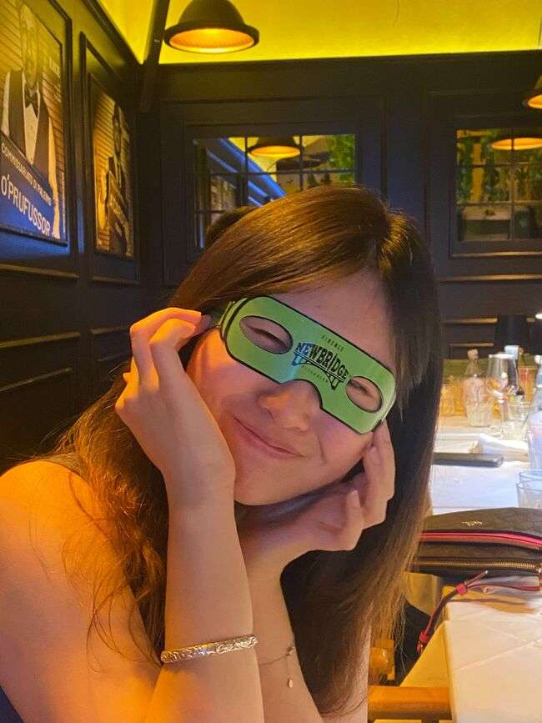
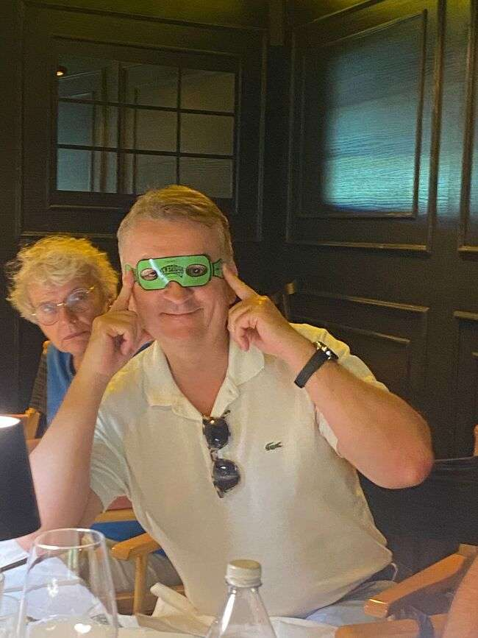
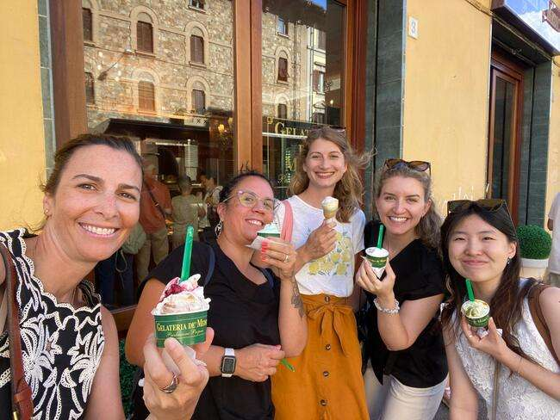
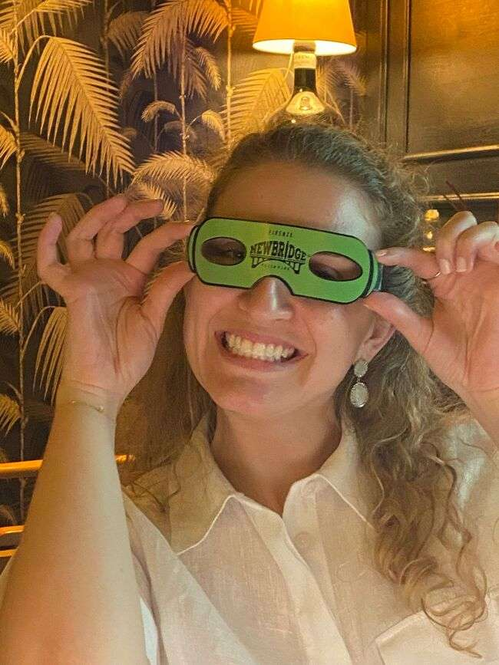
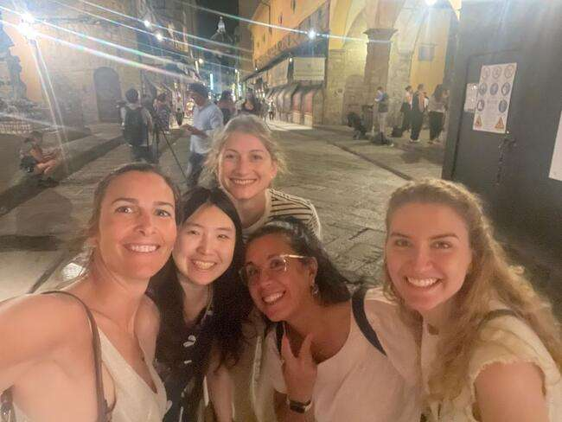

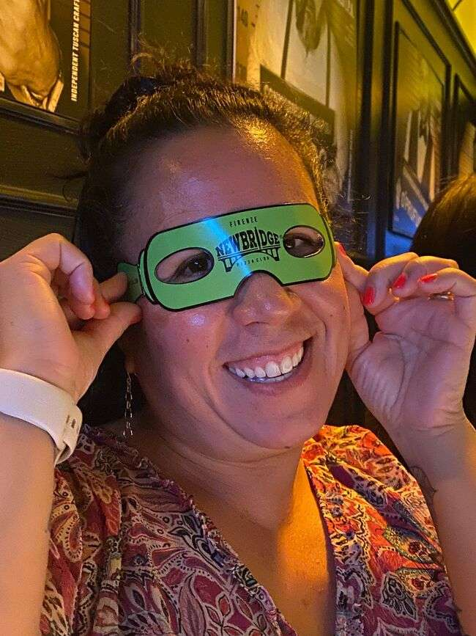
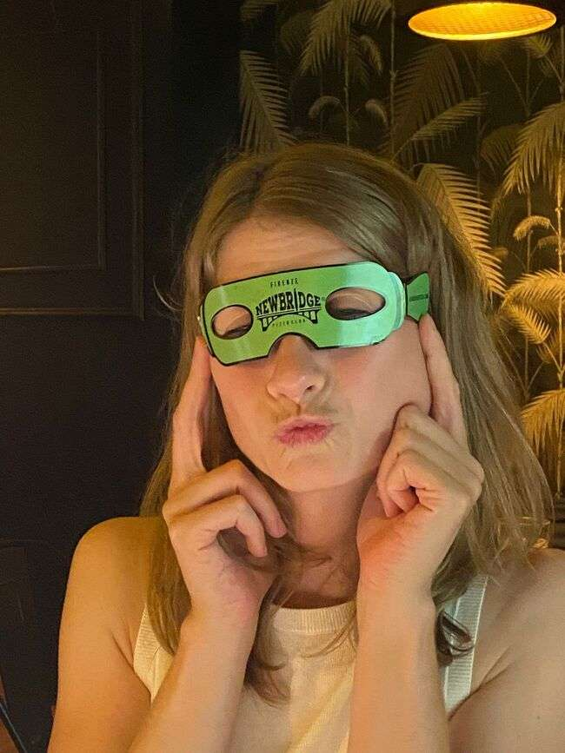
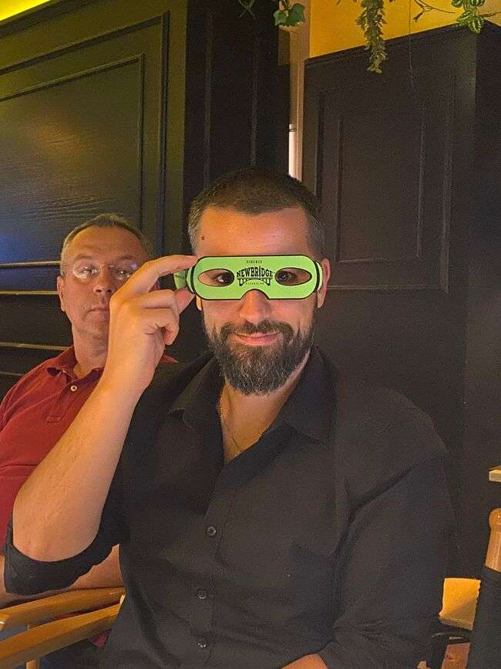

Slide 10
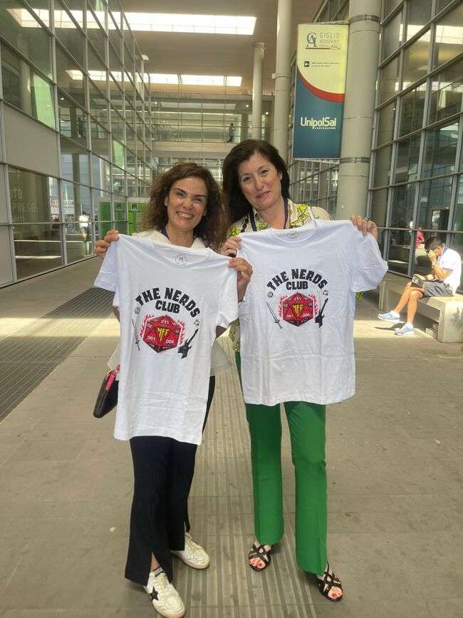
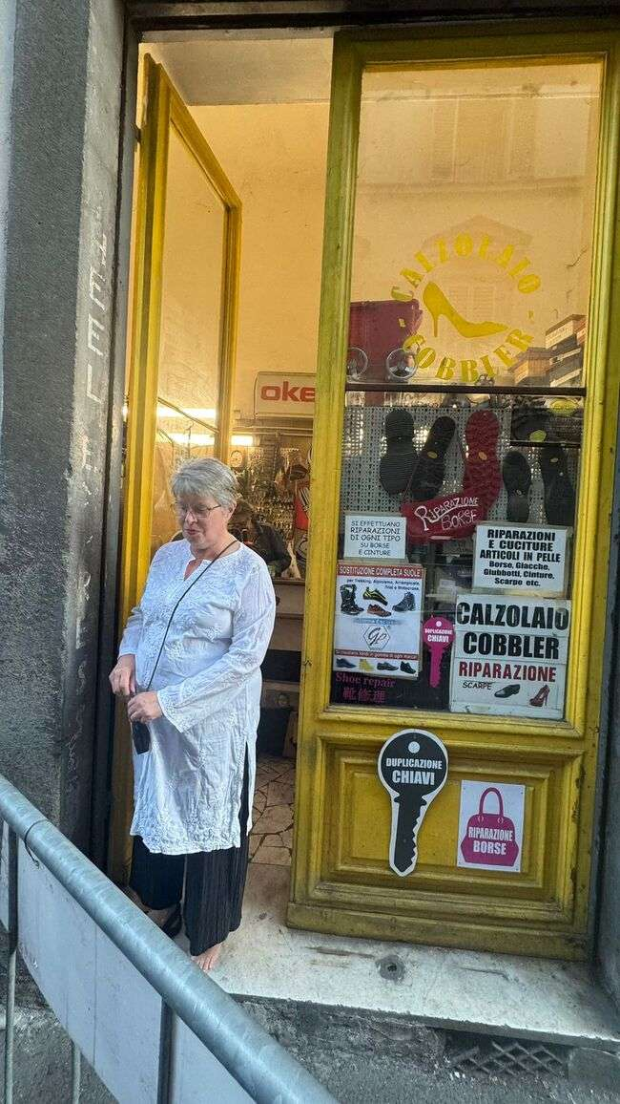
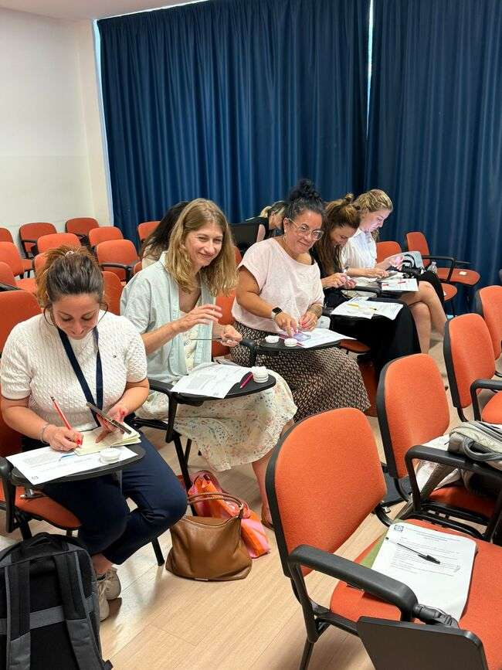

Slide 11
I.O.F.O.S. INTERNATIONAL COURSE IN FORENSIC ODONTOLOGY
AGE ESTIMATION WORKSHOP
July 7-11, 2025
Florence, Italy
FORTH DAY

Slide 12
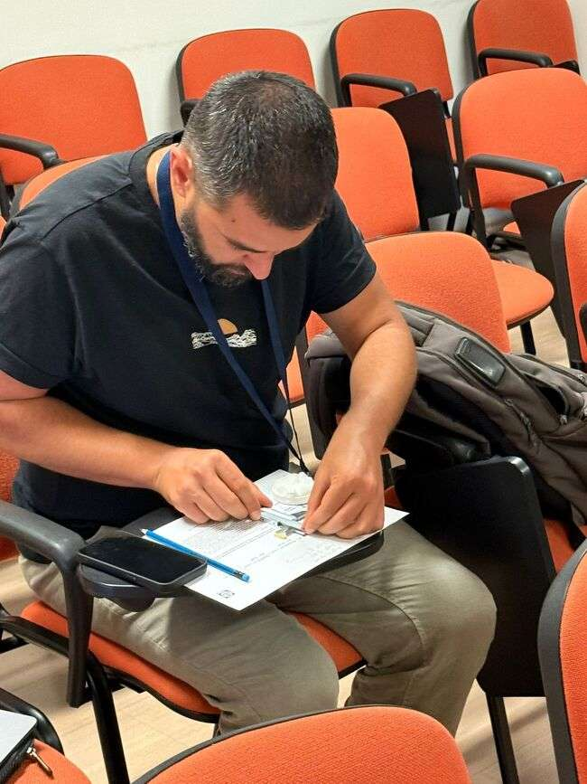
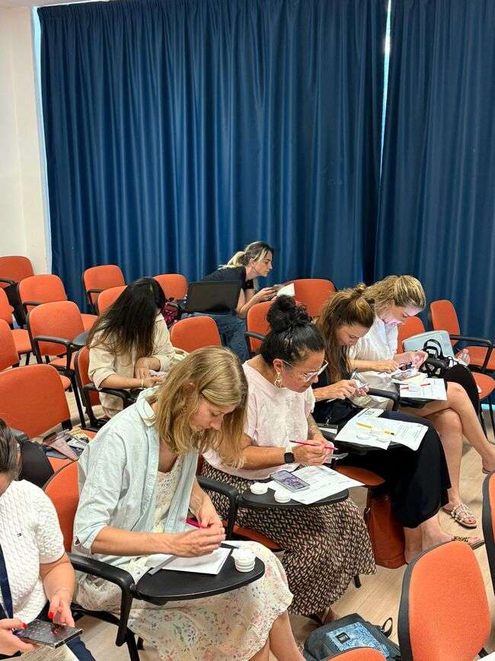
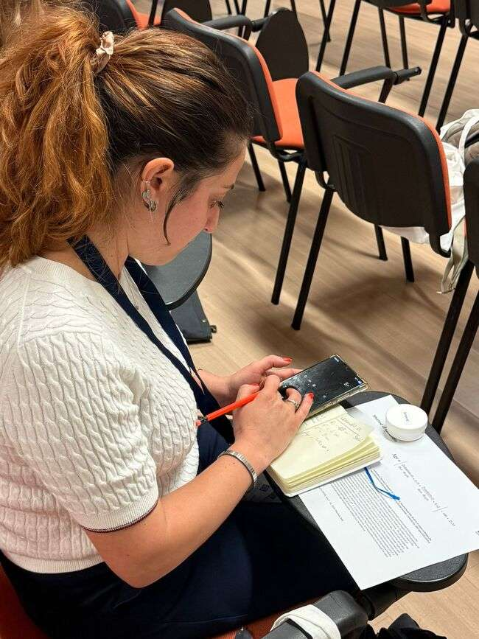
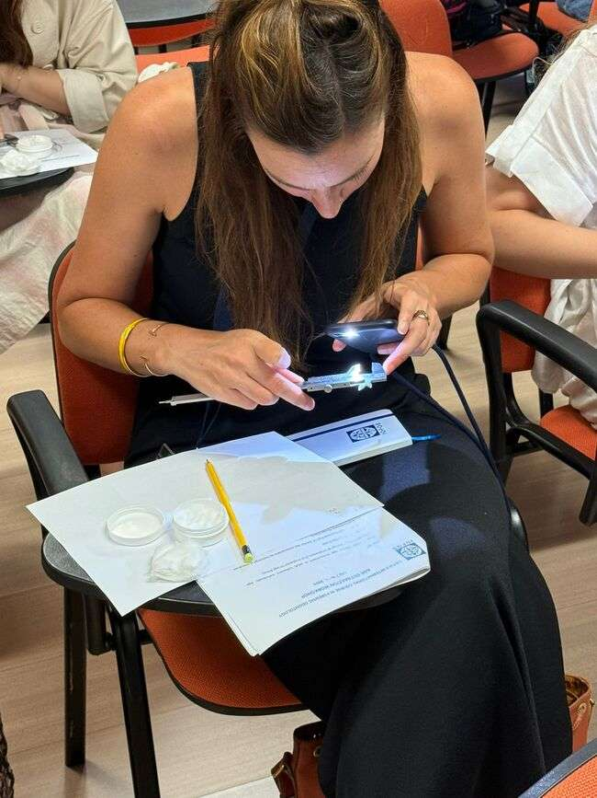
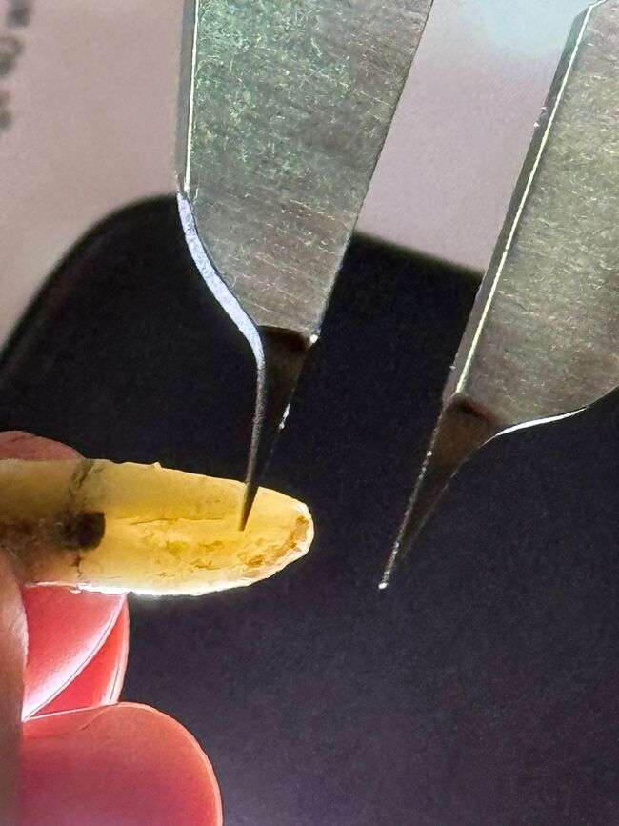
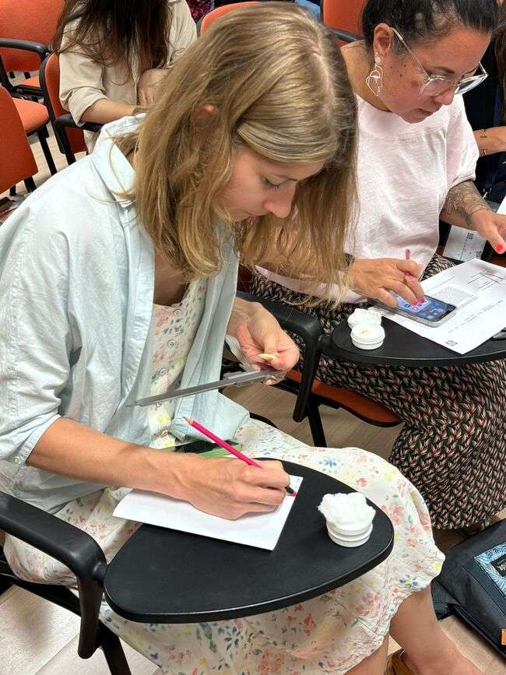
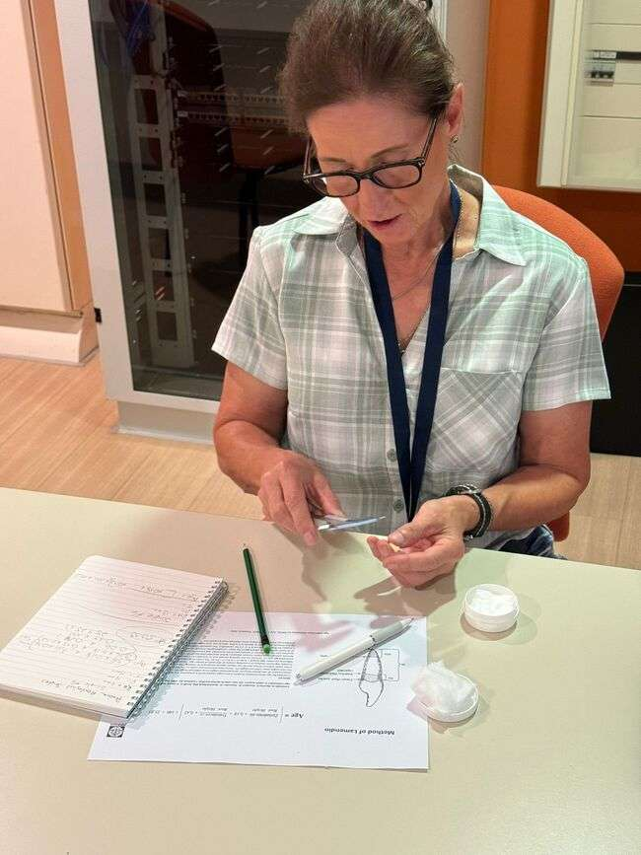


Slide 13




Slide 14








Slide 15
I.O.F.O.S. INTERNATIONAL COURSE IN FORENSIC ODONTOLOGY
AGE ESTIMATION WORKSHOP
July 7-11, 2025
Florence, Italy
FIFHT DAY

Slide 16






Slide 17


Slide 18



Notes:
I HOPE TO SEE YOU ALL IN LISBON, THANK YOU SO MUCH FOR YOUR ATENTION.

Slide 19


Slide 20



EDUCATION
2025/2026
cpereira@edu.ulisboa.pt

Slide 21

I.O.F.O.S. INTERNATIONAL COURSE IN FORENSIC ODONTOLOGY
AGE ESTIMATION WORKSHOP
July 7-11, 2025
Florence, Italy
Big Hand

Slide 22


I.O.F.O.S. INTERNATIONAL COURSE IN FORENSIC ODONTOLOGY
AGE ESTIMATION WORKSHOP
July 7-11, 2025
Florence, Italy
NEW GENERATION

